Slide 1
CSCI 4588/5588, ML-II Chapter 5: Unsupervised Learning
Md Tamjidul Hoque

Slide 2
Unsupervised Learning
The previous chapters have been concerned with predicting the values of one or more outputs or response variables Y = (Y₁, …, Y_{m}) for a given set of input or predictor variables X^{T} = (X₁, … , X_{p}) – those were supervised learning or, “learning with a teacher.”
Under this metaphor the “student” presents an answer for each in the training sample, and the supervisor or “teacher” provides either the correct answer and/or an error associated with the student’s answer.
On the contrary, we address unsupervised learning as “learning without a teacher”, basically unsupervised learning problem is samples without being told their categories or the outcomes.
For the unsupervised learning, there is no such direct measure of success like the supervised learning.

Slide 3
Association Rules
Association rule analysis has emerged as a popular tool for mining commercial data bases.
The goal is to find joint values of the variables X = (X₁, X₂, … , X_{p}) that appear most frequently in the data base.
In this context the observations are sales transactions, such as those occurring at the checkout counter of a store. The variables represent all of the items sold in the store.
For observation i, each variable X_{j} is assigned one of two values; x_{ij} = 1 if the j^{th} item is purchased as part of the transaction, whereas x_{ij} = 0 if it was not purchased.
Those variables that frequently have joint values of one represent items that are frequently purchased together.
This information can be quite useful for stocking shelves, cross-marketing in sales promotions, catalog design, and consumer segmentation based on buying patterns.
Next, we will study clustering which will help use segmentation data for a variety of useful goals.

Slide 4
Cluster Analysis
Cluster analysis, also called data segmentation, has a variety of goals.
All relate to grouping or segmenting a collection of objects into subsets or “clusters,” such that those within each cluster are more closely related to one another than objects assigned to different clusters.
This involves successively grouping the clusters themselves so that at each level of the hierarchy, clusters within the same group are more similar to each other than those in different groups.
Central to all of the goals of cluster analysis is the notion of the degree of similarity (or dissimilarity) between the individual objects being clustered.
A clustering method attempts to group the objects based on the definition of similarity supplied to it.

Slide 5
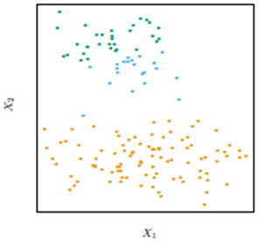
Clustering Analysis
FIGURE 14.4:
Simulated data in the plane, clustered into three classes (represented by orange, blue and green) by the K-means clustering algorithm.
In this case two of the clusters are not well separated, so that “segmentation” more accurately describes the part of this process than “clustering.”
K-means clustering starts with guesses for the three cluster centers. Then it alternates the following steps until convergence:
for each data point, the closest cluster center (in Euclidean distance) is identified;
each cluster center is replaced by the coordinate-wise average of all data points that are closest to it.

Slide 6
K-means clustering algorithm
The K-means algorithm is one of the most popular iterative clustering methods. It is intended for situations in which all variables are of the quantitative type, and squared Euclidean distance:
is chosen as the dissimilarity measure.
Note that weighted Euclidean distance can be used by redefining the x_{ij} values.

Slide 7
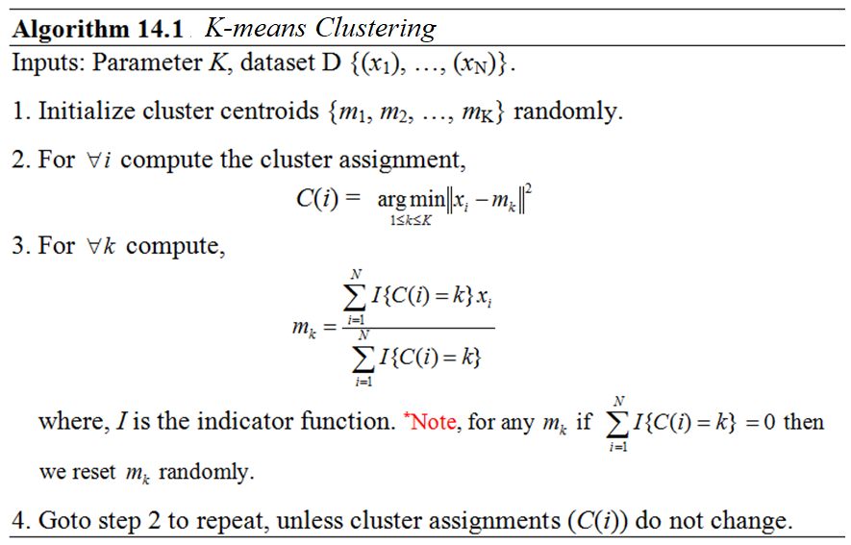
K-means clustering algorithm

Slide 8
K-means clustering algorithm
It is important to note that:
While initializing the centroids {m₁, m₂, …, m_{K}} randomly, it is better idea to pick sample points randomly and use them for initialization.
Also, the algorithm is initialization dependent and can result into locally optimal solution, thus it is better to run several times to check whether the globally optimal cluster or centroids are achieved or not.
To pick better set of centroids, out of different random runs, total cost using equation (i) can be used to compute and compare and to pick the one that has minimum cost.
… … (i)

Slide 9
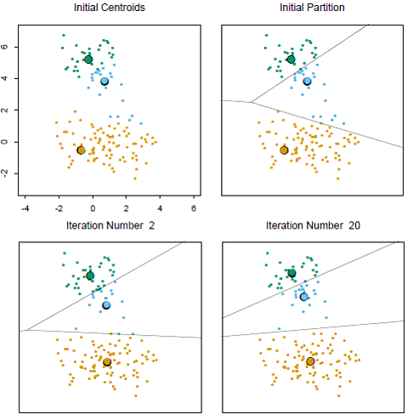
K-means clustering algorithm
FIGURE 14.6. Successive iterations of the K-means clustering algorithm for the simulated data of Figure 14.4.

Slide 10
Practical Issues
In order to apply K-means, one must select the number of clusters K and then initialize the centroids.
A choice for the number of clusters K depends on the goal.
For data segmentation K is usually defined as part of the problem. For example, a company may employ K salespeople, and the goal is to partition a customer database into K segments, one for each salesperson, such that the customers assigned to each one are as similar as possible.
Often, however, cluster analysis is used to provide a descriptive statistic for ascertaining the extent to which the observations comprising the data base fall into natural distinct groupings.
Here the number of such groups K* is unknown and one requires that it, as well as the groupings themselves, be estimated from the data.

Slide 11
Practical Issues
Data-based methods for estimating K* typically examine the within cluster dissimilarity W_{K} as a function of the number of clusters K. Separate solutions are obtained for K ∈ {1, 2, …, K_{max}}.
The corresponding values {W₁,W₂, … ,W_{Kmax}} generally decrease with increasing K.
If there are actually K* distinct groupings of the observations, then for K < K* the clusters returned by the algorithm will each contain a subset of the true underlying groups. That is, the solution will not assign observations in the same naturally occurring group to different estimated clusters.
To the extent that this is the case, the solution criterion value will tend to decrease substantially with each successive increase in the number of specified clusters, W_{K+1} ≪ W_{K}, as the natural groups are successively assigned to separate clusters.

Slide 12
Practical Issues
For K > K*, one of the estimated clusters must partition at least one of the natural groups into two subgroups.
This will tend to provide a smaller decrease in the criterion as K is further increased.
Splitting a natural group, within which the observations are all quite close to each other, reduces the criterion less than partitioning the union of two well-separated groups into their proper constituents.
To the extent this scenario is realized, there will be a sharp decrease in successive differences in criterion value, W_{K} − W_{K+1}, at K = K*. That is, {W_{K} − W_{K+1} | K < K*} ≫ {W_{K} − W_{K+1} | K ≥ K*}. An estimate for K* is then obtained by identifying a “kink” in the plot of W_{K} as a function of K.
As with other aspects of clustering procedures, this approach is somewhat heuristic.

Slide 13
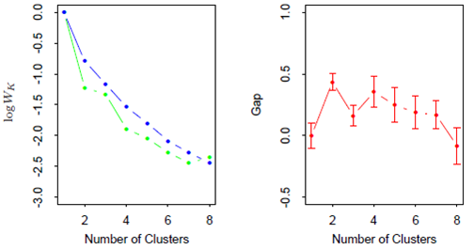
Practical Issues
FIGURE 14.11. (Left panel): observed (green) and expected (blue) values of log W_{K} for the simulated data of Figure 14.4. Both curves have been translated to equal zero at one cluster. (Right panel): Gap curve, equal to the difference between the observed and expected values of log W_{K}. The Gap estimate K* is the smallest K producing a gap within one standard deviation of the gap at K + 1; here K* = 2.

Slide 14
Hierarchical Clustering
The results of applying K-means clustering algorithms depend on the choice for the number of clusters to be searched and a starting configuration assignment.
In contrast, hierarchical clustering methods do not require such specifications.
Instead, they require the user to specify a measure of dissimilarity between (disjoint) groups of observations, based on the pairwise dissimilarities among the observations in the two groups.
As the name suggests, they produce hierarchical representations in which the clusters at each level of the hierarchy are created by merging clusters at the next lower level.
At the lowest level, each cluster contains a single observation. At the highest level there is only one cluster containing all of the data.
Strategies for hierarchical clustering divide into two basic paradigms: agglomerative (bottom-up) and divisive (top-down).

Slide 15
A clustering problem: The Table below gives corporate data on 22 US public utilities. We are interested in forming groups of similar utilities. There are 8 measurements on each utility, as described below.

Slide 16
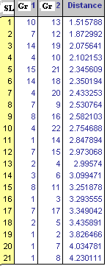
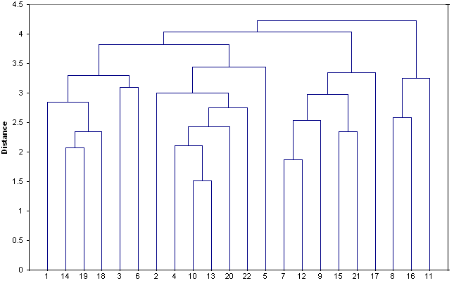
Hierarchical Clustering: Using Dendrogram
Problem statement: Assume, in a 2D plane we have 22 points, based on the distances given among themselves, we have to develop a dendrogram.
---- x ----
Notes:
% ///// Demo from MATLAB //////
rng('default') % For reproducibility
X = rand(10,3);
tree = linkage(X,'average'); % // Create a hierarchical binary cluster tree using linkage.
figure()
dendrogram(tree)

